Slide 1
11693 Team 6
First Sprint Presentation
Rui Wang, Victor Zhao
Carol Cheng, Hua Tang, Yan Zhao
Notes:
In today’s presentation, I want to introduce the progress of our first sprint, the issues of the project that we are trying to solve, and the future planning.

Slide 2



Architecture
CollectionReader
Analysis Engine
CASConsumer
concept
doc
Triple
Input
Output
Notes:
The first thing that I want to show is the general architecture of our project, which strictly follow the instruction provided on the M1 and M2 handouts. There are three annotators that have been accomplished so far.

Slide 3
Architecture—aeDescriptor
Type: AtomicQueryConcept
Set ConceptSearchResult
set Document
set Triple
(Uri, Score, Text, Rank, Query String)
Type: Question
Set AtomicQueryConcept
Concept
Annotator
Original Data Stream
Question
Annotator
Document
Annotator
Evaluate
Triple
Annotator
aeDescriptor
Notes:
Here is the data flow description. Under the UIMA framework, all of the raw data can be processed into different level of contents that we need to generate the answer for a given question. By storing those data into the corresponding types, the final stage of this pipeline evaluate the performance to give us the feedback and let us improve it.

Slide 4
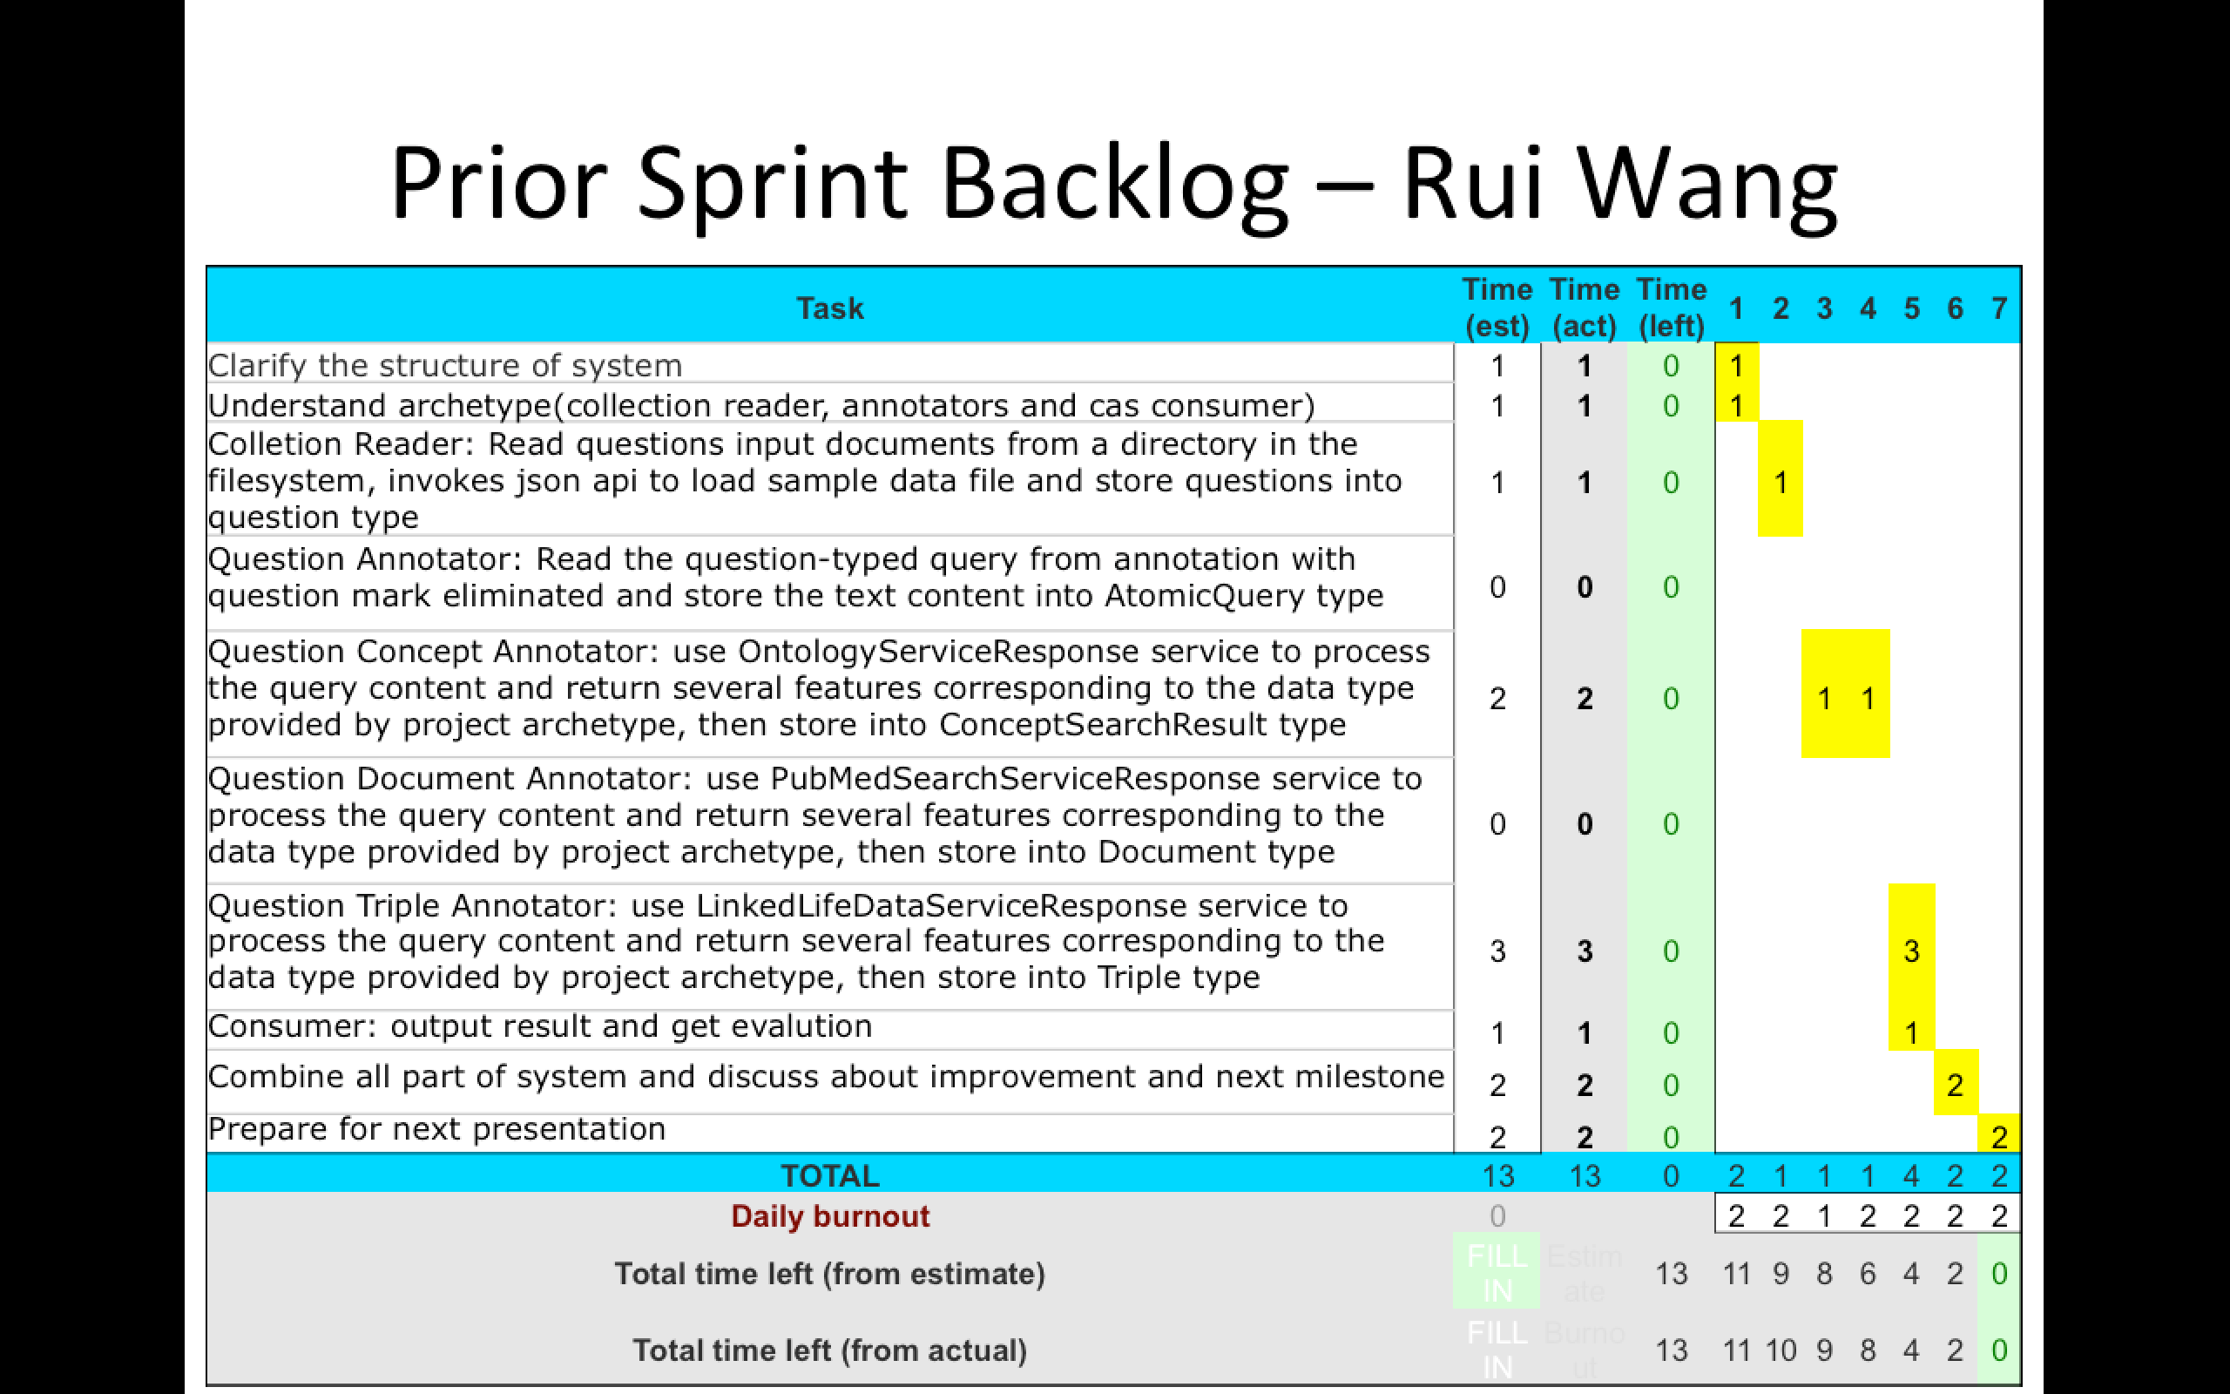
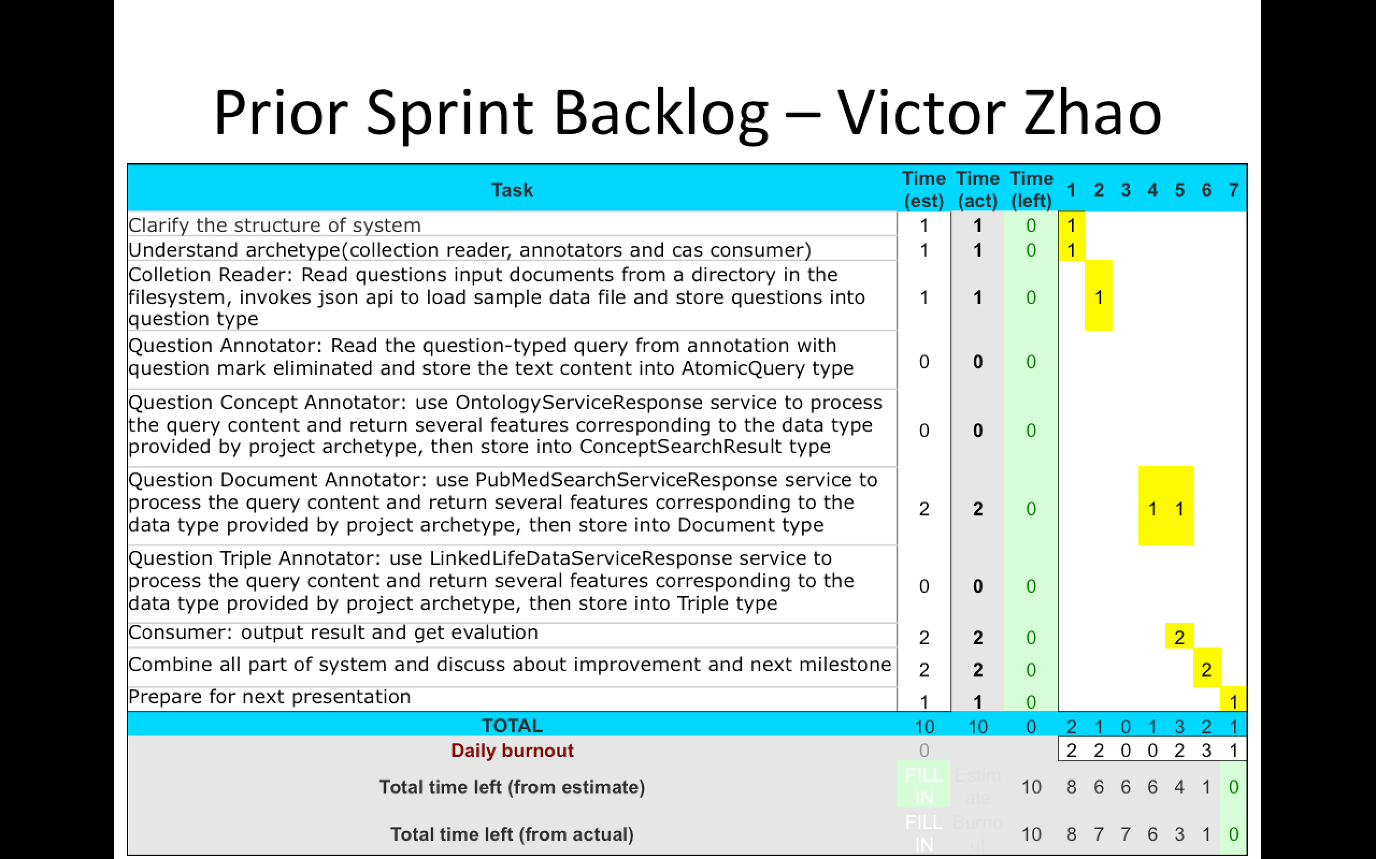
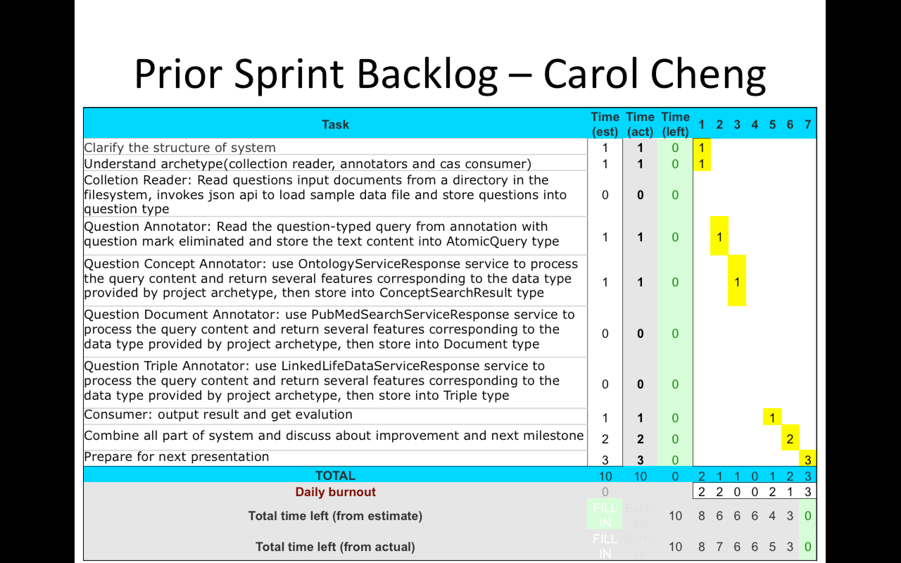
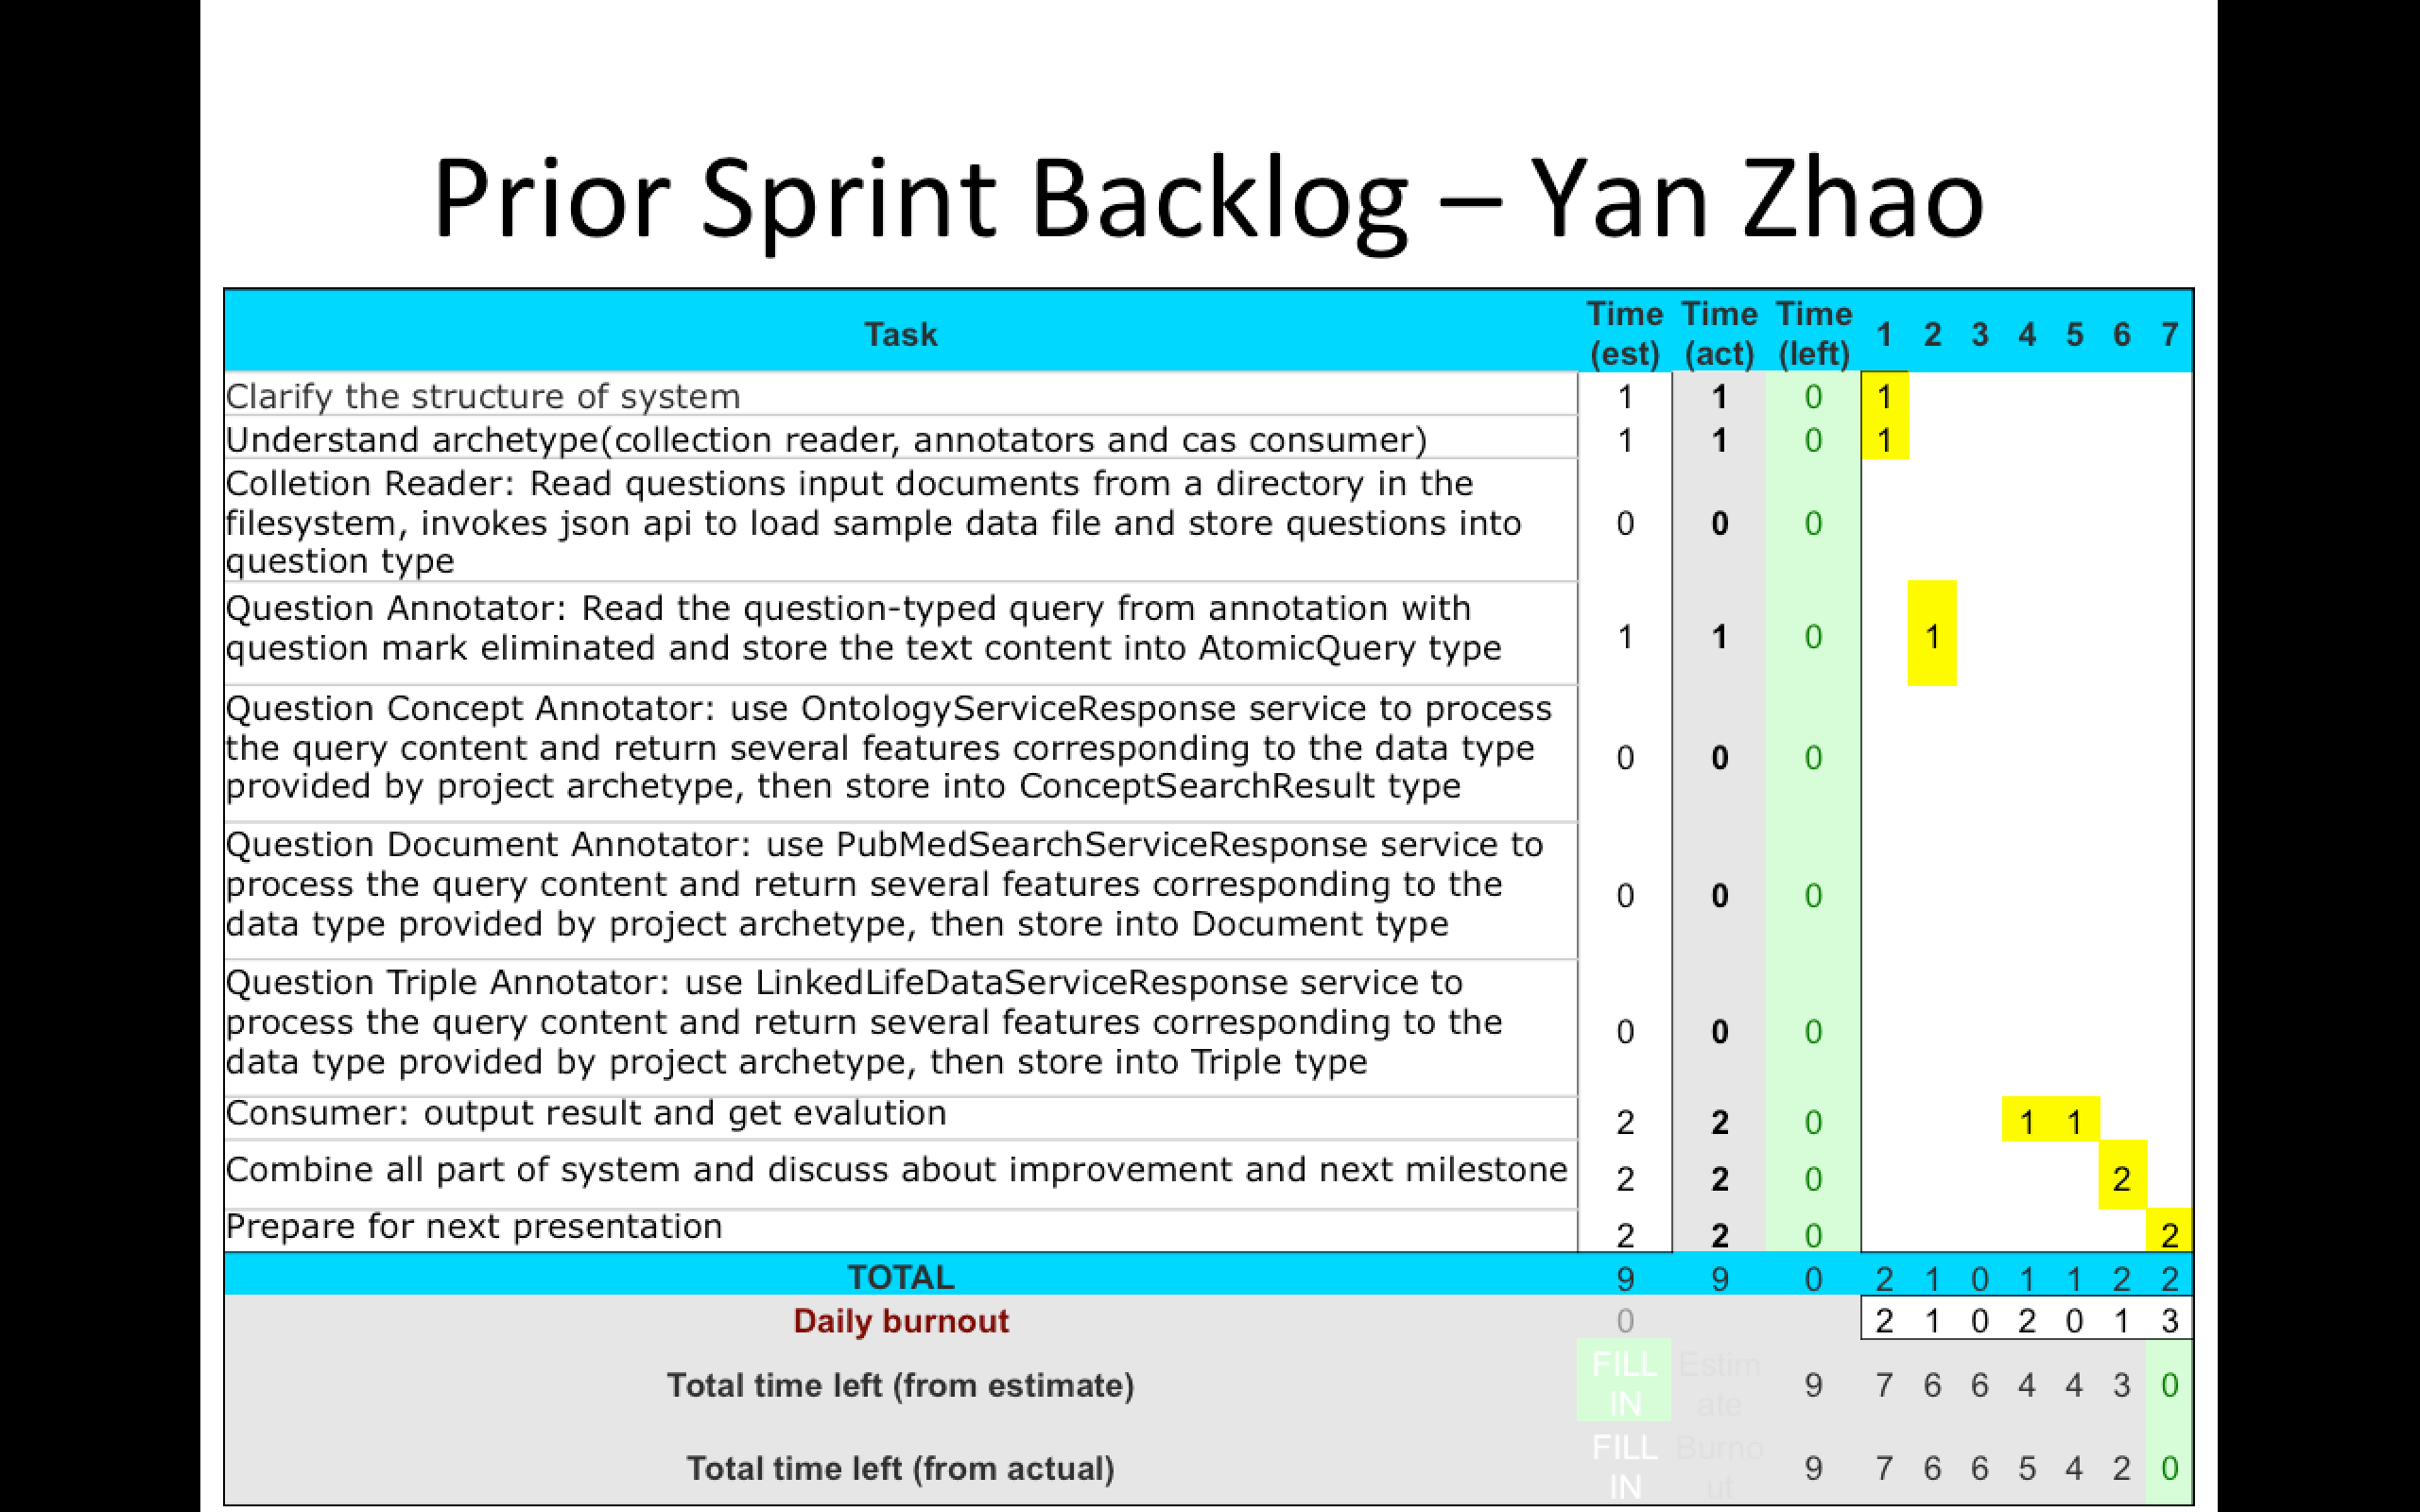

Prior Sprint Backlog
Rui Wang
Victor Zhao
Carol Cheng
Yan Zhao
Hua Tang
Notes:
Next, the Prior Sprint Backlog.
In terms of our task arrangement, Carol, Yan, and Hua mainly focus on data preprocessing, maintaining documentation, and integration of the whole system. On the other hands, Rui and I mainly focus on coding the core part of the system, the analysis engine, service API, and the evaluation methods.
Much more alike.

Slide 5
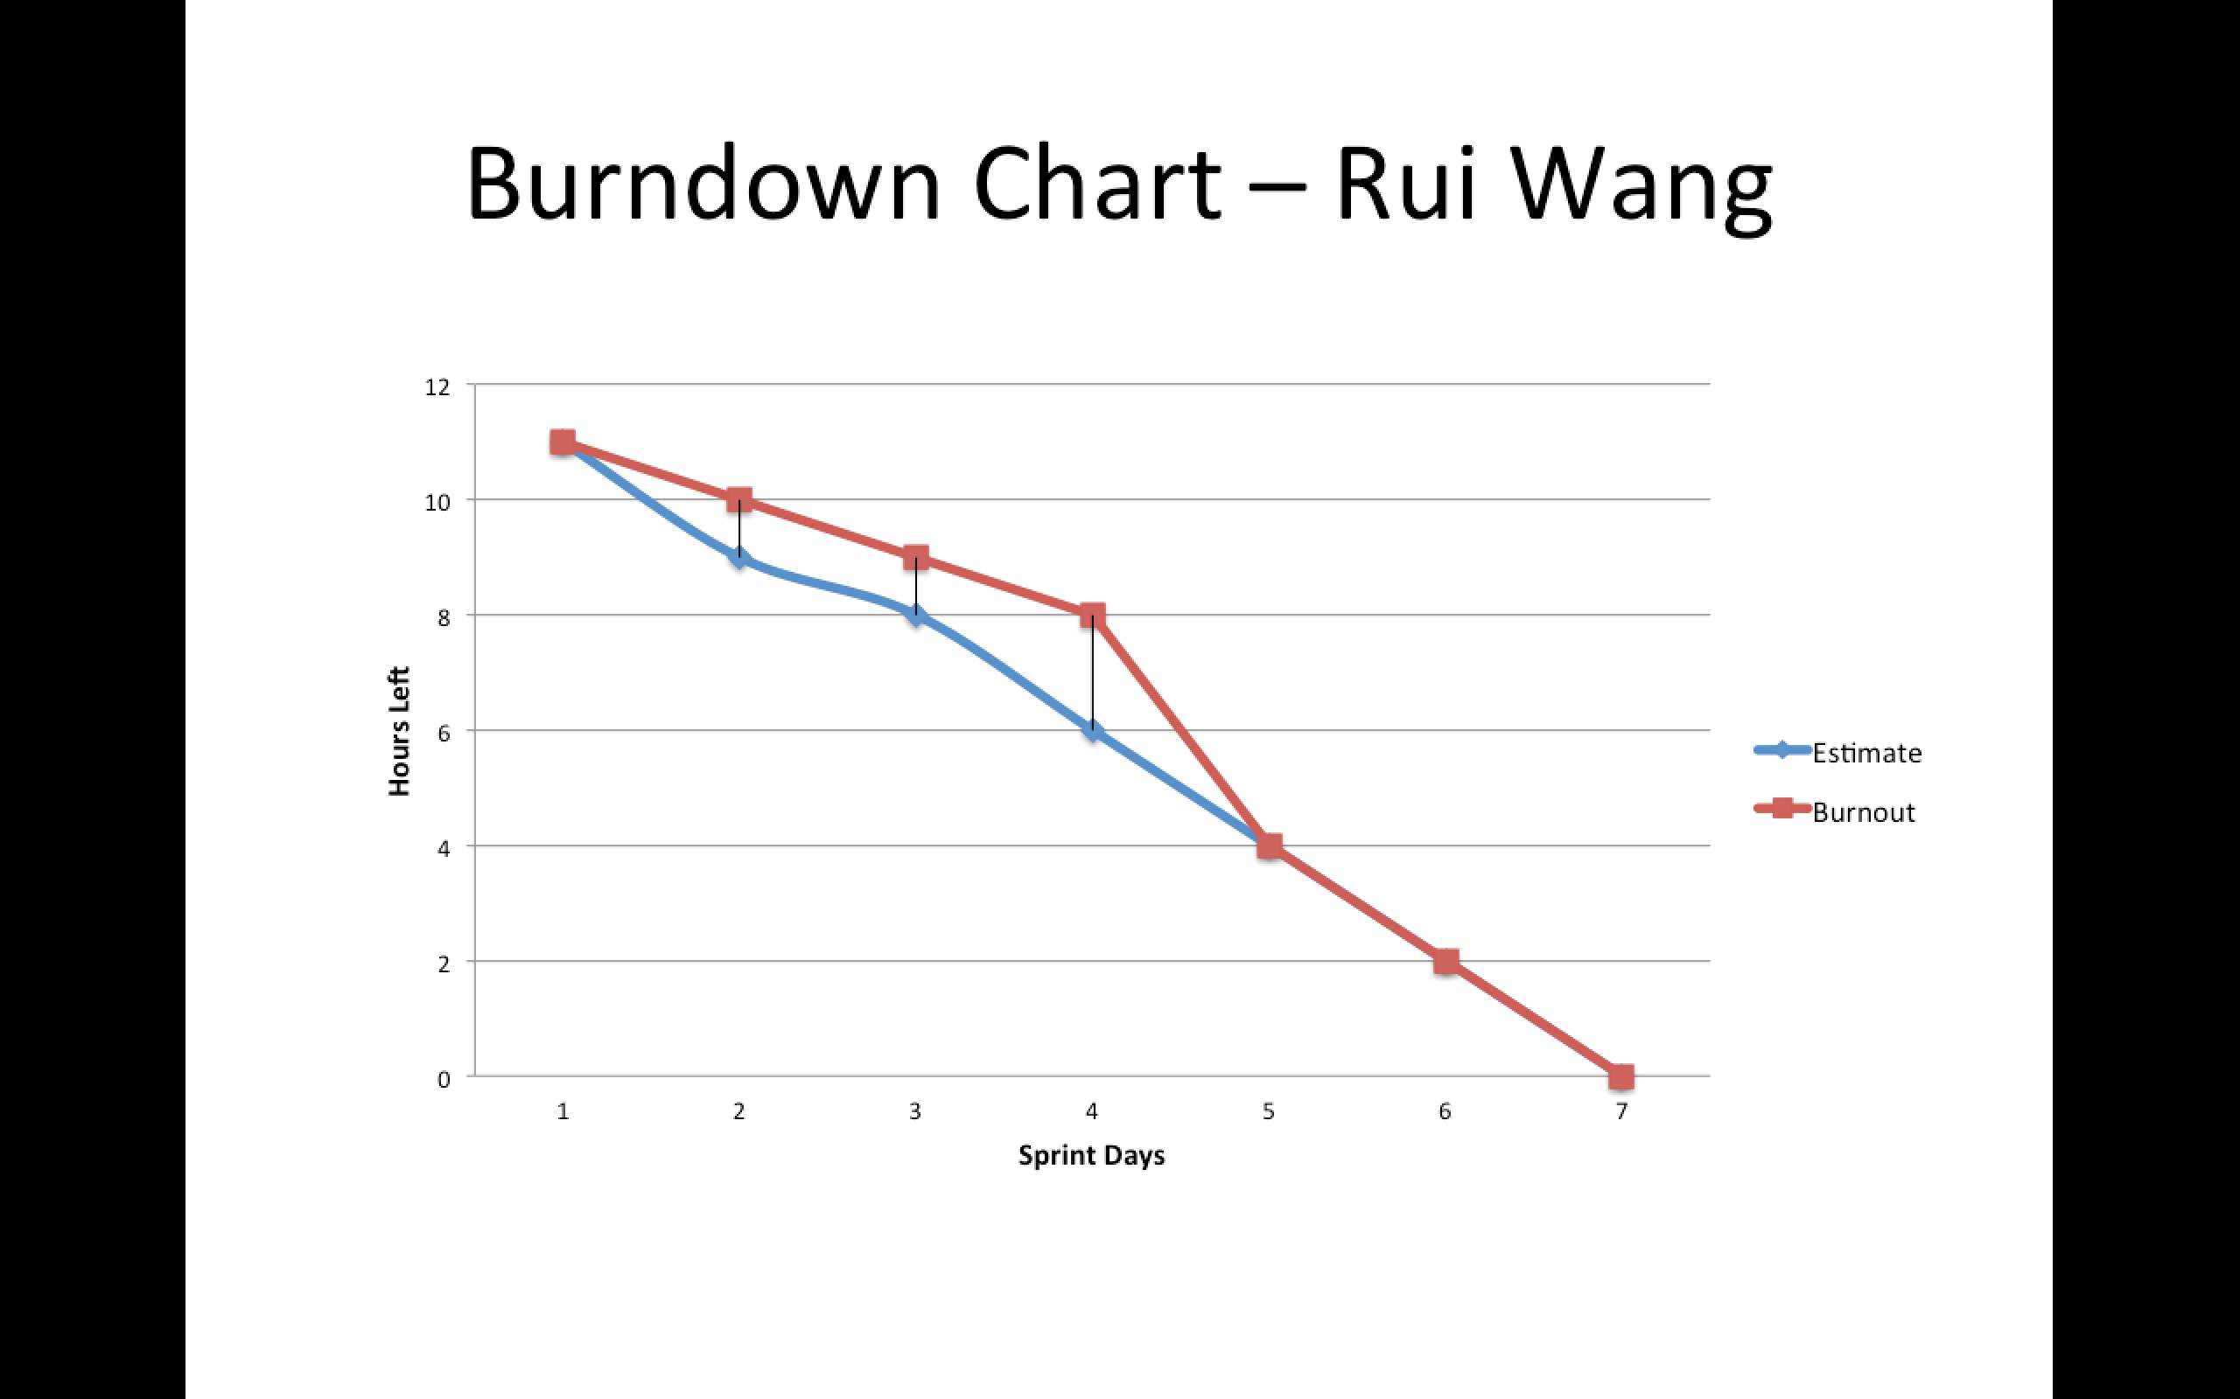
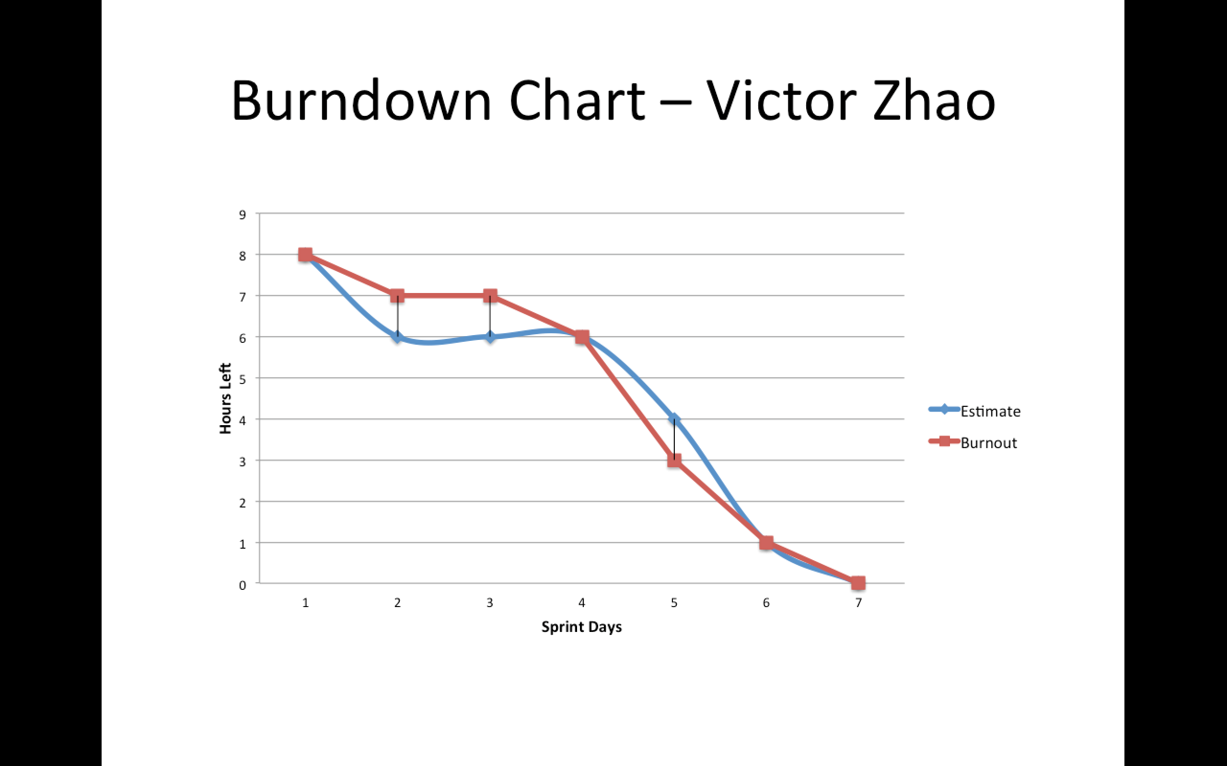
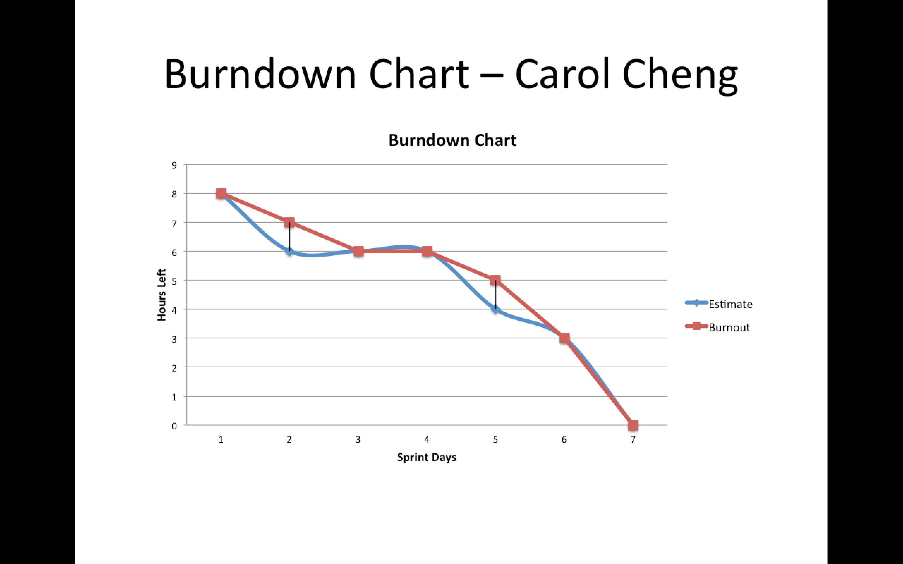
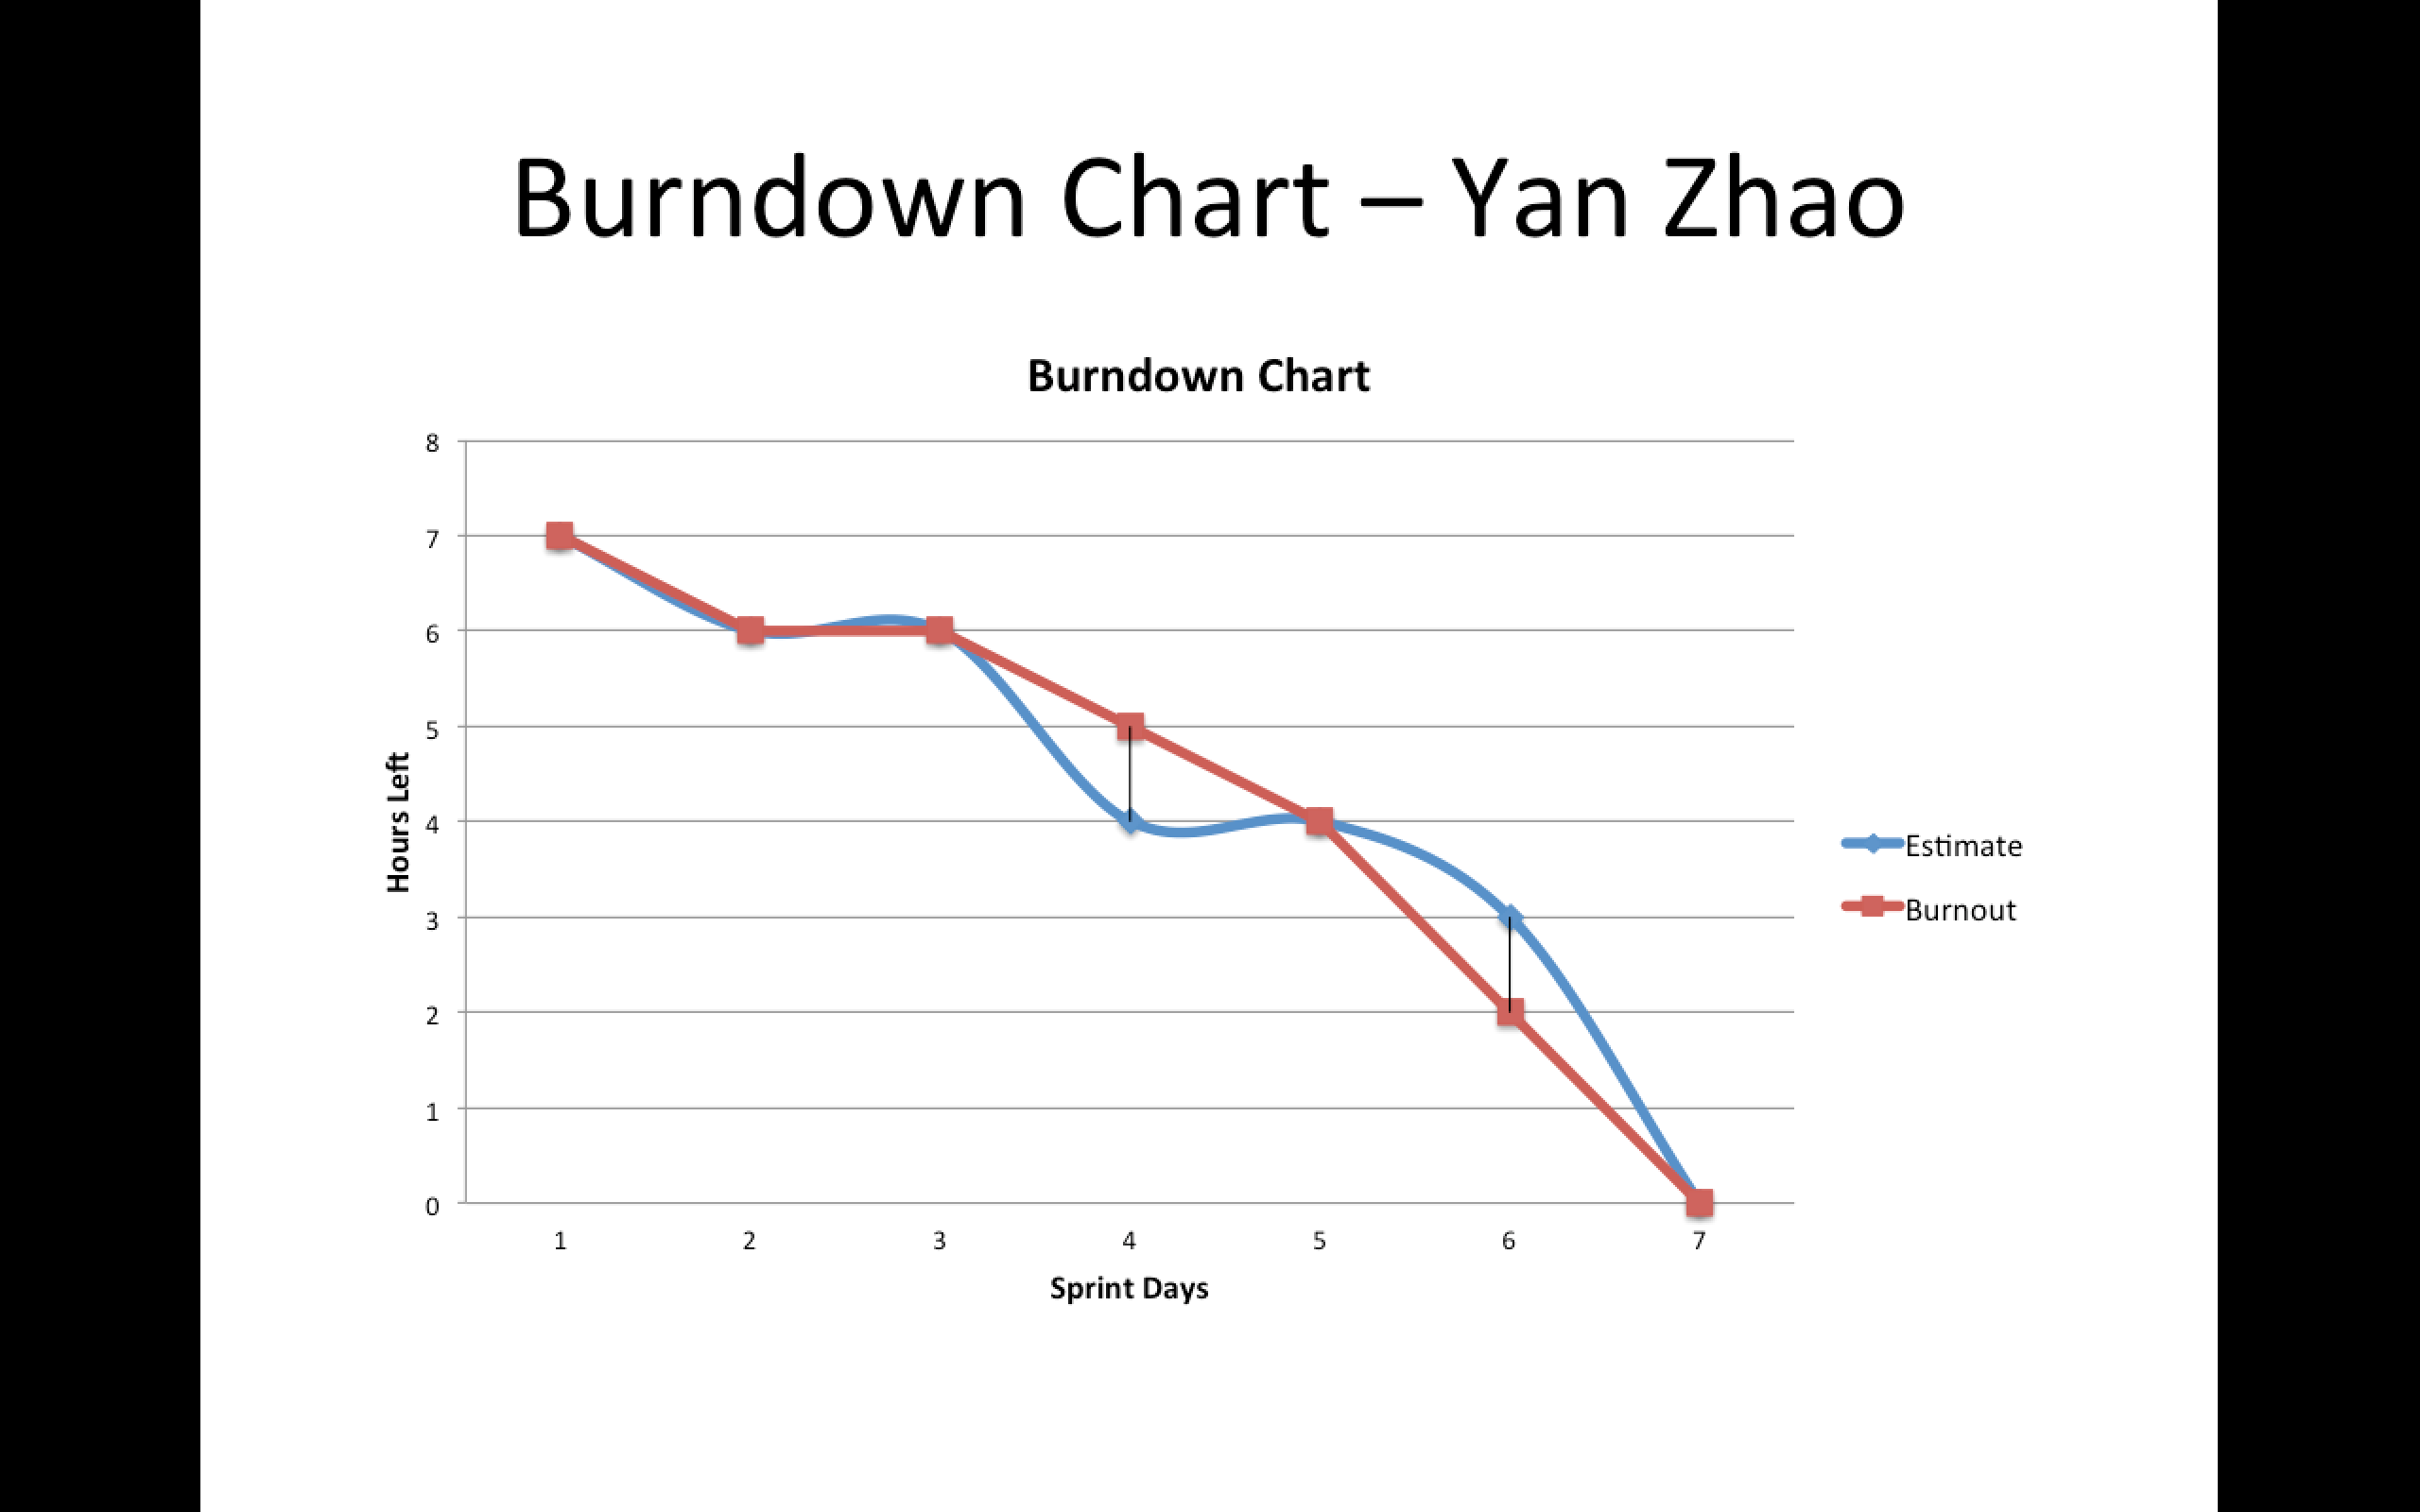
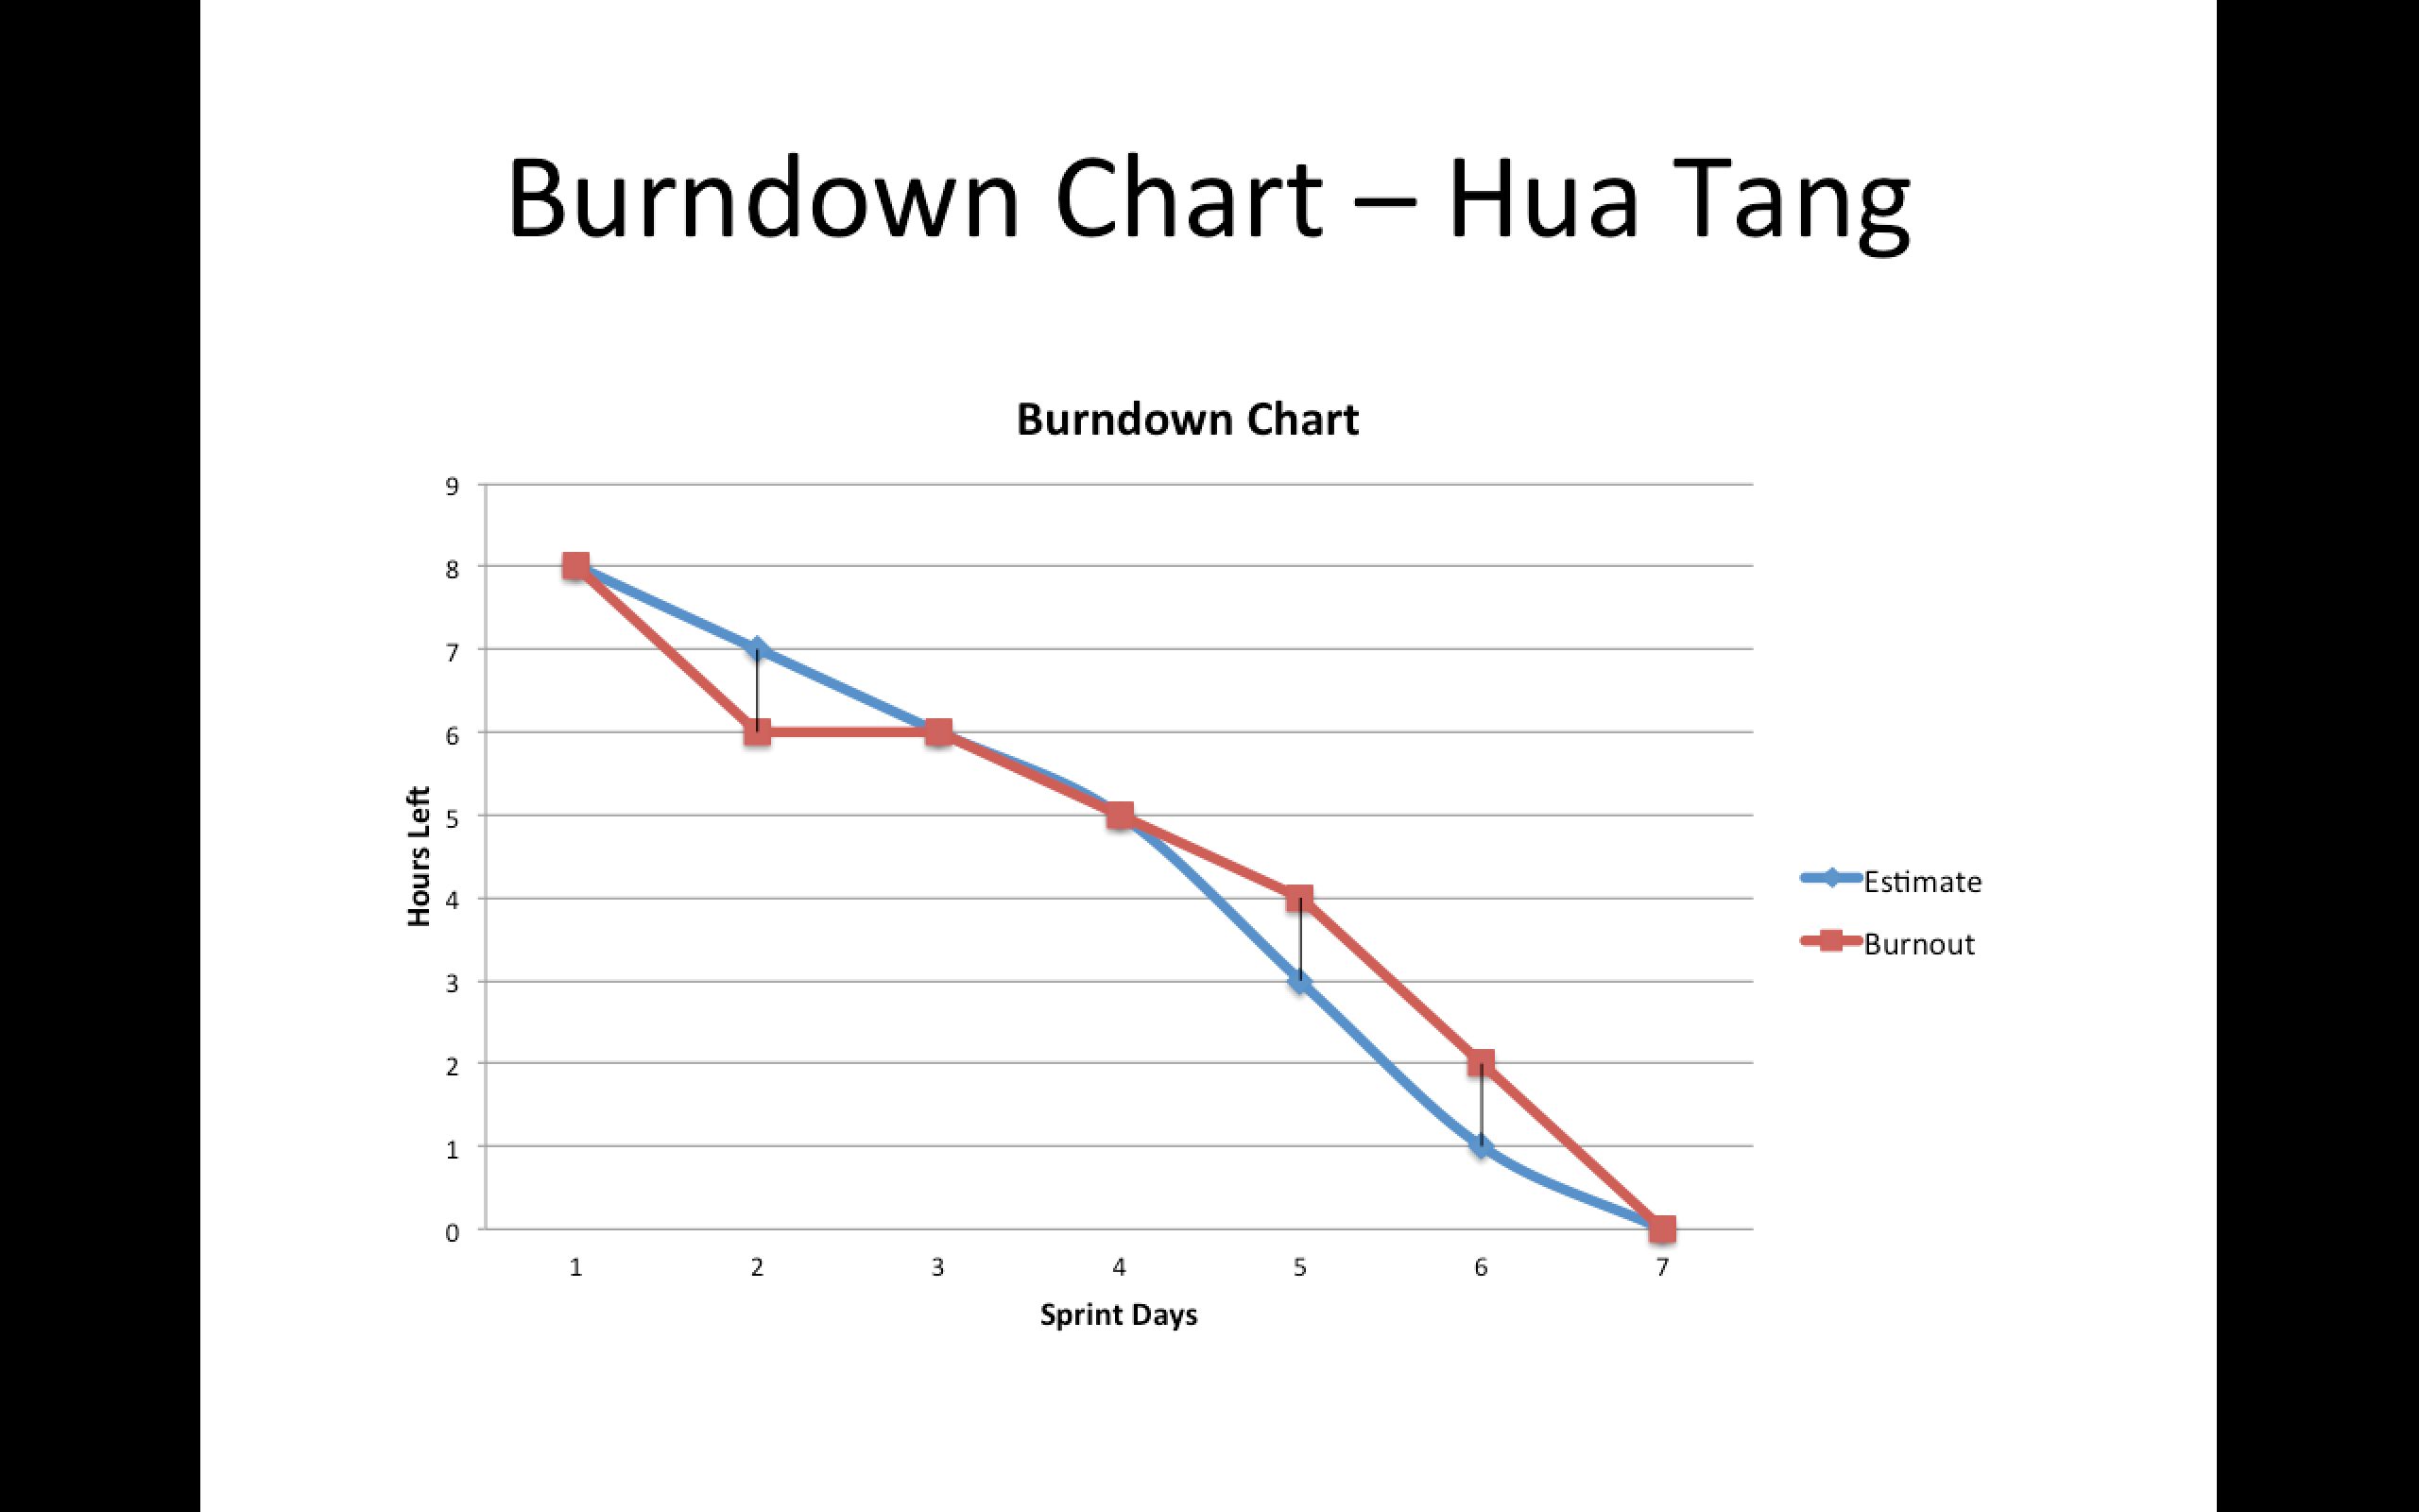
Prior Sprint Burndown
Rui Wang
Victor Zhao
Carol Cheng
Yan Zhao
Hua Tang
Notes:
Burndown chart.
Most of us felt hard to absorb new knowledge at the very beginning. So there seems a little bit delay at the very beginning.
Catch up at finally!

Slide 6
Prior Sprint Backlog — Rui Wang
Notes:
Now, let me show you an example by introducing our leader, Rui’s chart.

Slide 7
Prior Sprint Burndown Chart—Rui Wang
Notes:
Most of us felt hard to absorb new knowledge at the very beginning. So there seems a little bit delay at the very beginning.

Slide 8
Prior Sprint Retrospective
Team Member | Set the Stage (how did you feel this sprint) | What Happend this sprint | Why did those things happen | What To Do to keep up what worked well and prevent what didn't
Rui Wang | Great | Build the archetype including the Collection Reader, Concept Annotator, Document Annotator, Triple Annotator and Consumer, inform the team members about the pipeline. | Improve coding skill | Read materials, get acknowledged about the system
Victor Zhao | Great | Build the archetype including the Collection Reader, Concept Annotator, Document Annotator, Triple Annotator and Consumer, to complete the evaluator in Consumer. | Learn to build QA system | Know about the pipeline, try give more help to other teammates.
Carol Cheng | Good | Get familiar with the pipeline. Help to build Question Annotator, Document Annotator, Triple Annotator. | Practice coding ability and learn software management | To get more familiar with the system, including the collection reader, annotator and consumer.
Yan Zhao | Good | Get familiar with the pipeline. Help to build Question Annotator,Concept Annotator, and Consumer. | Learn Intelligence System | To get more familiar with the system, including the collection reader, annotator and consumer. Code for the next sprint sprint.
Hua Tang | Good | Get familiar with the pipeline. Help to build Collection Reader, Document Annotator, and Triple Annotator. | Learn software engineering method | To get more familiar with the system, including the collection reader, annotator and consumer.
Notes:
Next, the sprint retrospective reflects each of our personal view on what we have finish so far. As it can be seen from this chart, everyone, well, have learnt a lot and feel satisfied.

Slide 9
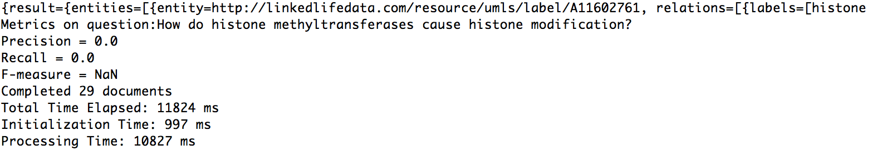
Performance
Why does not the performance meet our expectation?
Notes:
Most important thing, is the result that we have. Right. Now here come the actual performance of our system.
We simply use the GoPubMed service to get all the retrieval information back.

Slide 10
Refinement
Tokenize question by removing stopwords and stemming
Utilize operators to do query reformulation
ComplexQueryConcept
Synonym & Phrase
Notes:
How are we going to solve it?
Nothing hit successfully. Is there something wrong with the reader? No. Or something wrong with the evaluation function. Well, we’ve already test those thing in the previous assignment.
After negotiating with TAs, we figured out that there needs a lot of improvement in building our query. By adapting the strategy that we used in HW3, like….
Furthermore, using operators to query reformulation like AND, OR, to connect different terms may achieve this goal, and we are focusing on realizing it.
Phrases : Apple + Company => Apple Company.

Slide 11
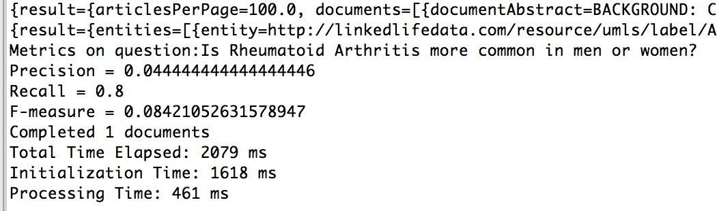
Performance

Slide 12
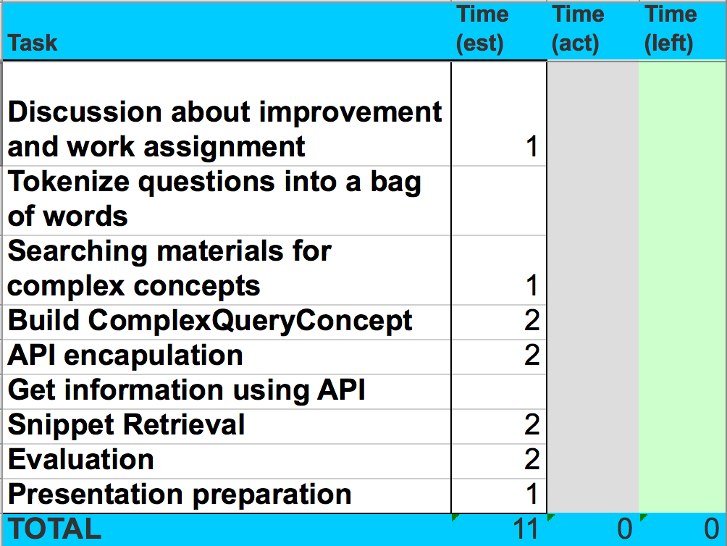
Next Sprint Backlog
—Rui Wang & Victor Zhao

Slide 13
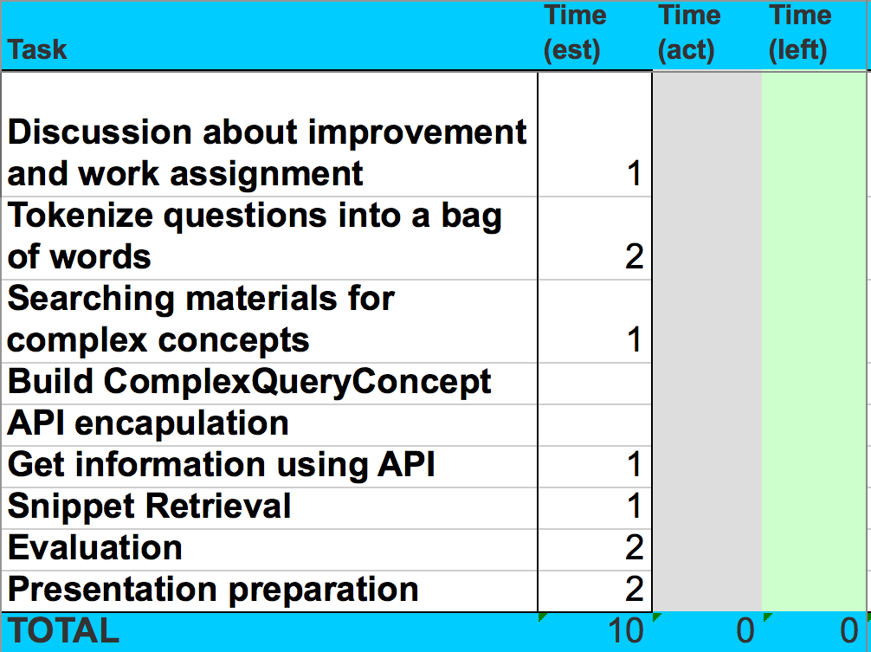
Next Sprint Backlog
—Carol Cheng, Yan Zhao & Hua Tang

Slide 14
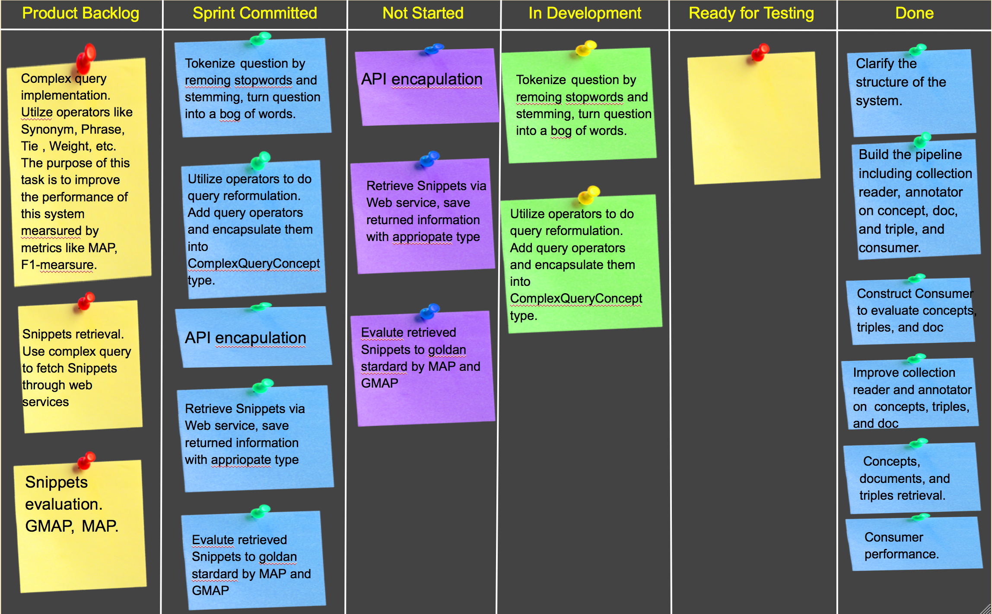
Story Wall
JSON format
Notes:
Product Backlog is sprint backlog actually.
… In development and not started.
I would like to give the appreciation to all of our team members for their efforts on our project. Thank you.

Slide 15
Questions?

